Slide 1
AVL trees

Slide 2
AVL trees
1.WHY : REDUCE HEIGHT OF TREE
2. OVERCOME: drawback of BST ,if BST is in ascending or decending order or sometimes treeis in large size/say height of tree is large

Slide 3
AVL Tree is invented by GM Adelson - Velsky and EM Landis in 1962. The tree is named AVL in honour of its inventors.
2 PROPRTIES : tree is avl if tree holds 2 proeprties (a)BST (b) Balancing factor (-1,0,1) means heightof left-right subtree of every node will be this.=>how find height
AVL Tree can be defined as height balanced binary search tree in which each node is associated with a balance factor which is calculated by subtracting the height of its right sub-tree from that of its left sub-tree.
Notes:
Insert a map of your country.

Slide 4
Tree is said to be balanced if balance factor of each node is in between -1 to 1,
otherwise, the tree will be unbalanced and need to be balanced.
Notes:
Insert a map of your country.

Slide 5
Balance Factor (k) = height (left(k)) - height (right(k))
If balance factor of any node is 1, it means that the left sub-tree is one level higher than the right sub-tree.
If balance factor of any node is 0, it means that the left sub-tree and right sub-tree contain equal height.
If balance factor of any node is -1, it means that the left sub-tree is one level lower than the right sub-tree.
Notes:
Insert a map of your country.

Slide 6
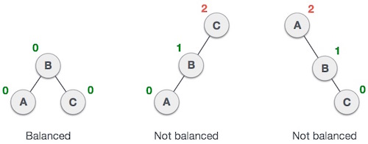
BalanceFactor = height(left-sutree) − height(right-sutree)
Notes:
Insert a map of your country.

Slide 7
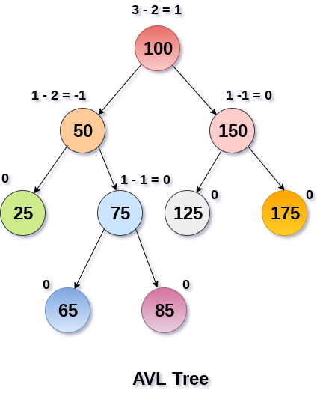
balance factor associated with each node is in between -1 and +1. therefore, it is an example of AVL tree.
Notes:
Insert a map of your country.

Slide 8
Operations on AVL tree
Due to the fact that, AVL tree is also a binary search tree therefore, all the operations are performed in the same way as they are performed in a binary search tree. Searching and traversing do not lead to the violation in property of AVL tree.
However, insertion and deletion are the operations which can violate this property and therefore, they need to be revisited
Notes:
Insert a map of your country.

Slide 9
Insertion in AVL tree is performed in the same way as it is performed in a binary search tree.
However, it may lead to violation in the AVL tree property and therefore the tree may need balancing.
The tree can be balanced by applying rotations.
Notes:
Insert a map of your country.

Slide 10
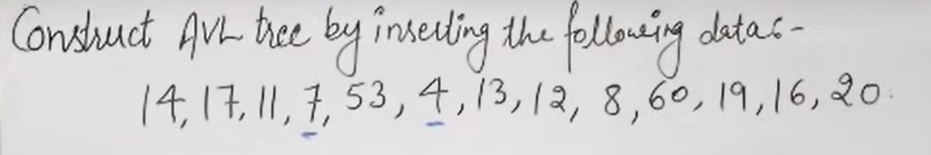

Slide 11
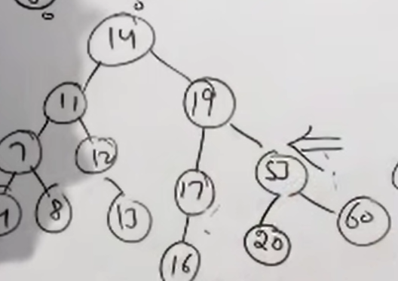

Slide 12
Deletion can also be performed in the same way as it is performed in a binary search tree.
Deletion may also disturb the balance of the tree therefore, various types of rotations are used to rebalance the tree.
Notes:
Insert a map of your country.

Slide 13
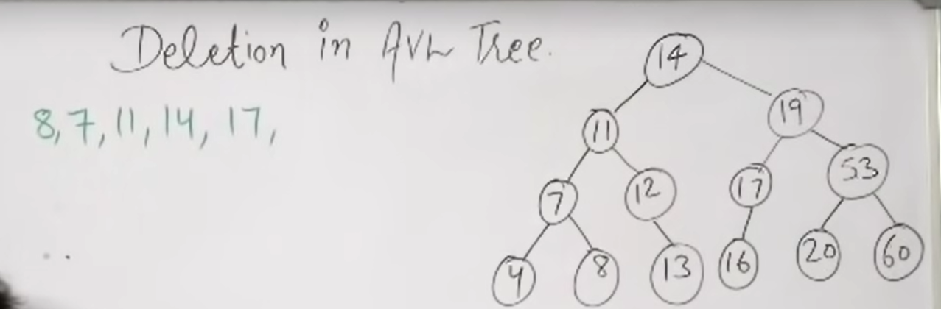

Slide 14
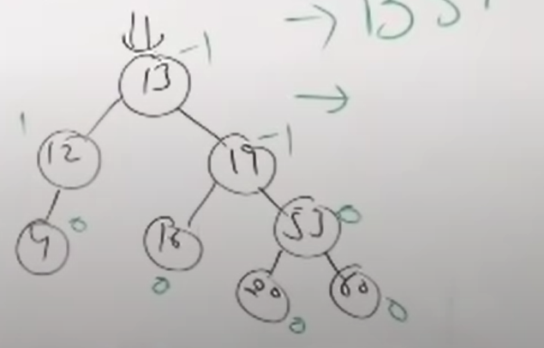

Slide 15
AVL Rotations
We perform rotation in AVL tree only in case if Balance Factor is other than -1, 0, and 1.
There are basically four types of rotations which are as follows:
L L rotation: Inserted node is in the left subtree of left subtree of A
R R rotation : Inserted node is in the right subtree of right subtree of A
L R rotation : Inserted node is in the right subtree of left subtree of A
R L rotation : Inserted node is in the left subtree of right subtree of A
Notes:
Insert a map of your country.

Slide 16
AVL Rotations
We perform rotation in AVL tree only in case if Balance Factor is other than -1, 0, and 1.
There are basically four types of rotations which are as follows:
L L rotation: Inserted node is in the left subtree of left subtree of A
R R rotation : Inserted node is in the right subtree of right subtree of A
L R rotation : Inserted node is in the right subtree of left subtree of A
R L rotation : Inserted node is in the left subtree of right subtree of A
Notes:
Insert a map of your country.

Slide 17
Where node A is the node whose balance Factor is other than -1, 0, 1.
The first two rotations LL and RR are single rotations and the next two rotations LR and RL are double rotations.
For a tree to be unbalanced, minimum height must be at least 2,
Let us understand each rotation
Notes:
Insert a map of your country.

Slide 18
RR Rotation
When BST becomes unbalanced, due to a node is inserted into the right subtree of the right subtree of A, then we perform RR rotation,
RR rotation is an anticlockwise rotation, which is applied on the edge below a node having balance factor -2
Notes:
Insert a map of your country.

Slide 19
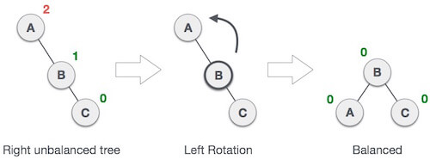
In above example, node A has balance factor -2 because a node C is inserted in the right subtree of A right subtree. We perform the RR rotation on the edge below A.
Notes:
Insert a map of your country.

Slide 20
LL Rotation
When BST becomes unbalanced, due to a node is inserted into the left subtree of the left subtree of C, then we perform LL rotation
LL rotation is clockwise rotation, which is applied on the edge below a node having balance factor 2.
Notes:
Insert a map of your country.

Slide 21
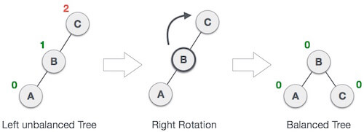
In above example, node C has balance factor 2 because a node A is inserted in the left subtree of C left subtree. We perform the LL rotation on the edge below A.
Notes:
Insert a map of your country.

Slide 22

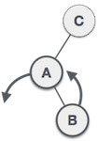
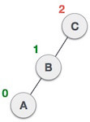
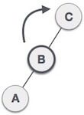
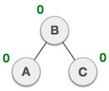
LR Rotation
LR Insertion = LL rotation then RR rotation
Notes:
Insert a map of your country.

Slide 23

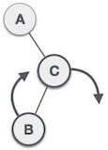
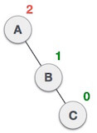
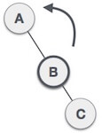
RL Rotation
R L insertion = RR rotation then LL rotation
Notes:
Insert a map of your country.

Slide 24
AVL INSERTION

